Slide 1
Office 365 Development

Slide 2


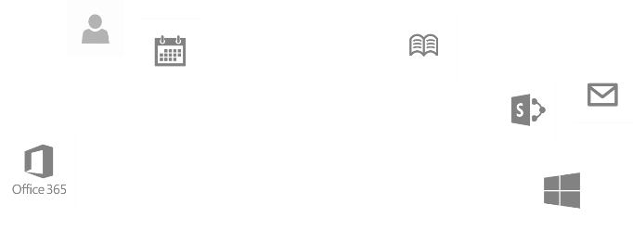
Recap
Deep Dive into Integrating Office 365 APIs with Web Applications
Module 1: Deep Dive into Azure AD with the Office 365 APIs
Module 2: Deep Dive into Office 365 APIs for Calendar, Mail, and Contacts
Module 3: Deep Dive into Office 365 APIs for OneDrive for Business
Module 4: Deep Dive into Office 365 APIs for SharePoint Site services
Module 5: Deep Dive into Office 365 APIs for Yammer services
Module 6: Deep Dive into Office 365 APIs for Office Graph
Module 7: Deep Dive into Office 365 APIs for OneNote services
dev.office.com/training

Slide 3
This Course Agenda
Deep Dive into Integrating Office 365 APIs with mobile device development
Module 1: Universal Windows App Development with Office 365 APIs in Visual Studio 2013
Module 2: Cordova Development with Office 365​ APIs in Visual Studio 2013
Module 3: Xamarin Development with Office 365 APIs in Visual Studio 2013
Module 4: Deep dive into native Android Development with Office 365 APIs
Module 5: Deep dive into native iOS Development with Office 365 APIs

Slide 4
Deep dive into native Android Development with Office 365 APIs

Slide 5

Agenda
Intro
Azure AD Auth
Exchange APIs
OneDrive for Business APIs
SharePoint Lists APIs

Slide 6
Intro
Getting started with Mobile development with Office 365

Slide 7















Vision
EXTEND OFFICE EVERYWHERE
CONNECT TO OFFICE 365 SERVICES
BUILD USING AN OPEN PLATFORM
Delve
z
Users and groups
Files
Mail
Calendar
My Apps
Video Portal
Contacts
Office Graph
Presentations
Documents
Spreadsheets
Lync
OneNote
Yammer

Slide 8

Android SDKs
SDK generated from OData CSDL
Standard interface for all platforms
Dependency Injection optimized for each platform:
HTTP clients, Async frameworks, JSON parsers
Authentication with Azure AD Authentication Libraries
Industry-standard dependency manager support
Gradle and JCenter (Android Studio)
Popular IDE Support
Eclipse, IntelliJ, Android Studio
Open source end to end

Slide 9
App Developer
Add dependencies using Gradle or JCenter
Start coding:
Create a DefaultDependencyResolver
Authenticate using ADAL
Create *Client class for services
Navigate API using the client

Slide 10
Getting Started
Android

Slide 11
Tools
Android Studio
Create a new Android project
Gradle
Dependencies are resolved automatically
Just add them to your build.gradle
Basic support for Eclipse now
Better support for Eclipse coming soon

Slide 12
Authentication with Azure AD
Android

Slide 13
Overview
Authentication with O365 SharePoint is handled by Azure AD.
Azure AD supports OAuth 2.0 – access tokens and refresh tokens.
The Active Directory Authentication Library (ADAL) provides UI and services for easily implementing Azure AD OAuth within an Android app.
Notes:
Security for O365 SharePoint, Exchange etc is handled by Azure AD.
We can authenticate apps with Azure AD using it’s OAuth 2.0 support – but implementing this manually is fiddly work.
There is a Microsoft library we can use: Active Directory Authentication Library (ADAL) – it implements OAuth authentication with Azure AD and wraps it up into a few easy method calls. This includes UI elements for prompting the user to sign in (hosts a web browser control).
Also provides methods for retrieving a new access token using an existing refresh token.

Slide 14
Features
Authentication UI
Support for two-factor
Caching (automatic token refreshing, silent auth)
Secure (tokens etc. are encrypted in the cache)

Slide 15
Authentication Process
Create AuthenticationContext
Call ADAL and acquire token (may prompt user)
Setup DependencyResolver, add credentials
Create Client(s)

Slide 16
Where can I find it?
https://github.com/AzureAD/azure-activedirectory-library-for-android
Supports both Eclipse and Android Studio
Can be included as source, as a binary AAR package from JCenter or as a JARs in your libs folder.
Notes:
The ADAL is hosted on GitHub, under the AzureAD account.
It has support for both Eclipse and Android Studio, and can be used in a few ways:
Included as source (clone from GitHub or obtain a source zip).
Included as a binary AAR package from Maven.
Included as a Jar in the libs folder.
Hosted in Maven: http://mvnrepository.com/artifact/com.microsoft.aad/adal/

Slide 17
How do I use it?
To add the ADAL to an Android Studio project add the following to your build.gradle file:
compile 'com.microsoft.aad:adal:1.0.+'
Android studio will automatically download the binaries and add them to your project.
Notes:
This slide covers installing the ADAL into an Android Studio project.
Simply add a compile statement to the build.gradle file for your project, and Android Studio/Gradle will take care of downloading the correct package and including it in your project.
e.g.
dependencies {
compile fileTree(dir: 'libs', include: ['*.jar'])
compile 'com.microsoft.aad:adal:1.0.2'
}

Slide 18
What else do I need?
Before continuing, you must register your Android app in Azure AD as a “native client” app, and obtain a client ID.
This client ID is then passed into the ADAL along with other information about your AD/O365 tenant.

Slide 19
Examples
See: http://dev.office.com/android

Slide 20
Securely storing tokens
While there are ADAL methods which accept passing refresh tokens, we don’t need to use them!
ADAL automatically caches access/refresh tokens securely
Tokens are encrypted using a private key you specify
Notes:
Best practice is to avoid caching refresh tokens yourself – the ADAL takes care of this for you.

Slide 21
AD Authentication Demos

Slide 22
Calling the O365 Exchange API
Android

Slide 23
Overview
The O365 Exchange SDK for Android provides programmatic access to your Mail, Calendar and Contacts in O365 Exchange Online
Authentication is handled by Azure Active Directory

Slide 24
Where can I find it?
https://github.com/OfficeDev/Office-365-SDK-for-Android
Install by adding to your build.gradle:
com.microsoft.services:outlook-services:0.9+
Notes:
“outlook-services” is the Outlook SDK itself.
You will also need to install a number of other dependencies explicitly.

Slide 25
What can I do with it?
Folders and Messages
Create, read, update and delete
Send new messages
Reply, reply all, forward messages
Manage attachments
Calendars and Events
Create, read, update and delete
Calendar groups
Send invites
Contacts
Create, read, update and delete
Notes:
http://dev.office.com/android

Slide 26
Exchange Demos

Slide 27
Calling the O365 OneDrive API
Android

Slide 28
Overview
The O365 OneDrive Pro SDK for Android provides programmatic access to the Files in in your O365 OneDrive for Business account.
Authentication is handled by Azure Active Directory

Slide 29
Where can I find it?
https://github.com/OfficeDev/Office-365-SDK-for-Android
Install by adding to your build.gradle:
com.microsoft.services:discovery-services:0.9+
com.microsoft.services:file-services:0.9+
Notes:
“discovery-services” is the Discovery SDK, used to resolve the user’s My SharePoint URL.
“file-services” is the OneDrive SDK.
You will also need to install a number of other dependencies explicitly.

Slide 30
What can I do with it?
Files
Create, read, update and delete Files and Folders
Upload and download File contents
Notes:
http://dev.office.com/android

Slide 31
OneDrive for Business Demos

Slide 32
Calling the O365 SharePoint Lists API
Android

Slide 33
Overview
The O365 Lists SDK for Android provides programmatic access to your Lists and List Items in O365 SharePoint Online
Authentication is handled by Azure Active Directory

Slide 34
Where can I find it?
https://github.com/OfficeDev/Office-365-SDK-for-Android
Install by adding to your build.gradle:
com.microsoft.services:list-services:0.9+

Slide 35
What can I do with it?
Lists
Enumerate lists
Enumerate list fields/columns
List Items
Enumerate list items
Create, read, update and delete list items
Notes:
http://dev.office.com/android

Slide 36
SharePoint Lists Demos
Notes:
https://intergen.visualstudio.com/DefaultCollection/_git/MSCorp.O365TrainingModules#path=%2FO3654-4+Deep+dive+into+native+Android+Development+with+Office+365+APIs%2F05+O365+SharePoint+Lists+SDK+for+Android&version=GBmaster&_a=contents

Slide 37
Summary
Intro
Azure AD Auth
Exchange APIs
OneDrive for Business APIs
SharePoint Lists APIs

Slide 38
Resources
See http://dev.office.com/android to get started.
ADAL: https://github.com/AzureAD/azure-activedirectory-library-for-android
Office 365 SDKs: https://github.com/OfficeDev/Office-365-SDK-for-Android

Slide 39
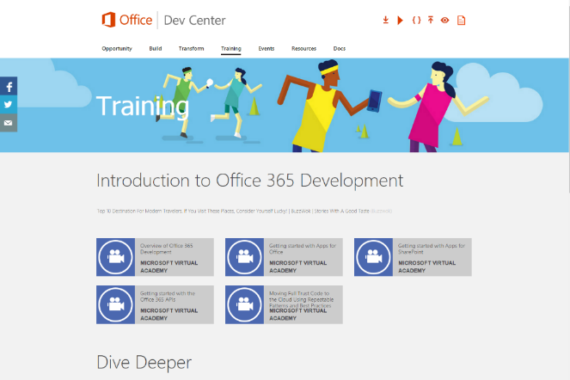
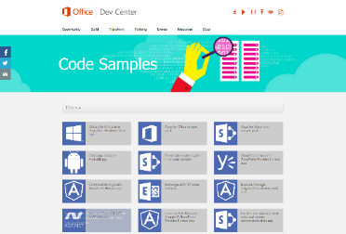

Building skills
Add screens shot from link
Microsoft Virtual Academy
dev.office.com/training
Code Samples
dev.office.com/code-samples
DX Office 365 Dev Camps
Office 365 Summit Developer Tracks
summit.office.com

Slide 40

Make look cool
Developer Patterns & Practices
Transform your code
Providing App Model Patterns for common SharePoint Full Trust Code and Office Add-in scenarios
60+ Visual Studio projects
Common scenarios Branding Site provisioning Remote event receivers
Large file support Taxonomy driven navigation And much more… aka.ms/OfficeDevPnP

Slide 41
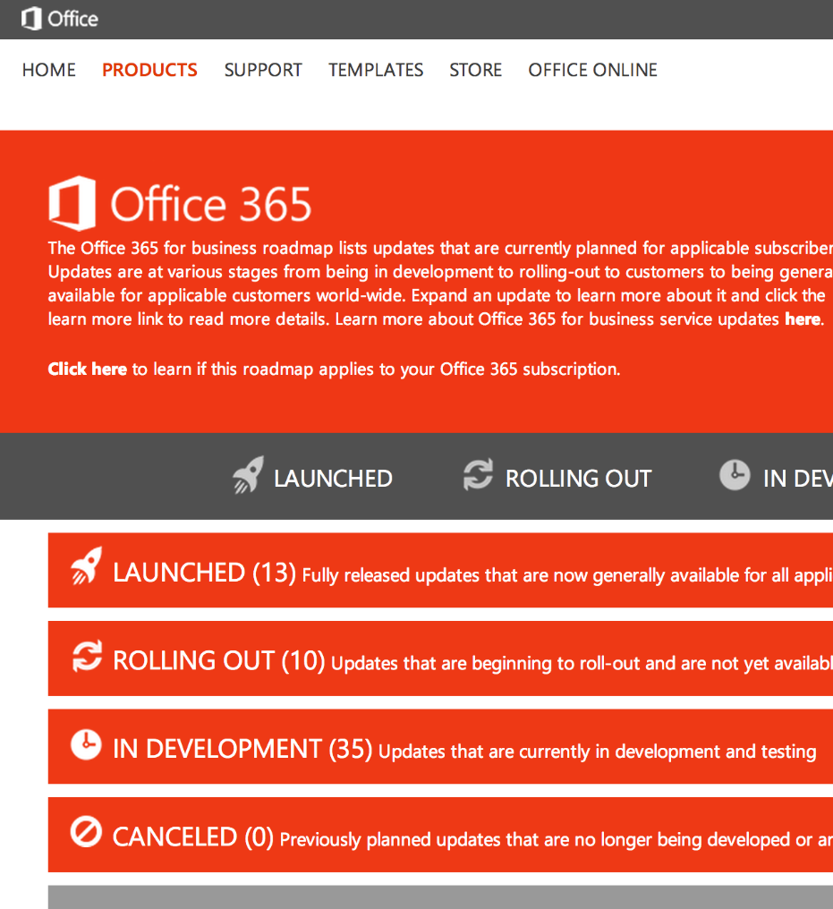
Roadmap
Monthly updates
Associated blog posts
www.office.com/roadmap

Slide 42
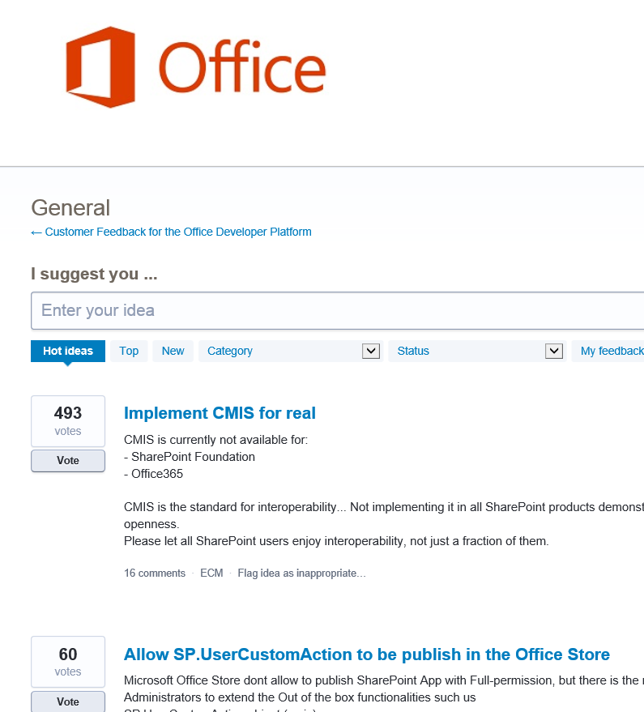

Customer feedback
Yammer Office 365 Technical Network
Stackoverflow
UserVoice Developer focused Bi-weekly triage Link to roadmap to show actions
http://aka.ms/OfficeDevFeedback

